Slide 1






GAS LEAKAGE DETECTION

Slide 2



OUR GOAL
The objective of our project is to detect leakages revolving around LPG-based cars, small-scale factories or in-home appliances . The leakage of LPG could lead to a variety of disasters. In case of a gas leakage, our system detects the same and alerts the surroundings.

Slide 3
Market Overview
In homes & automobiles, the gases are stored in one place and are used at other places. They're often carried using pipelines.
These pipelines are made up of rubber and have joints & bends. Over the years, these points wear out and the gas leakage eventually occurs.
And this is where our project shows its significance!

Slide 4



COMPONENTS
ARDUINO UNO
BUZZER
SERVO MOTOR
Your paragraph text
BREADBOARD
GAS SENSOR
JUMPER WIRES
LED DISPLAY

Slide 5
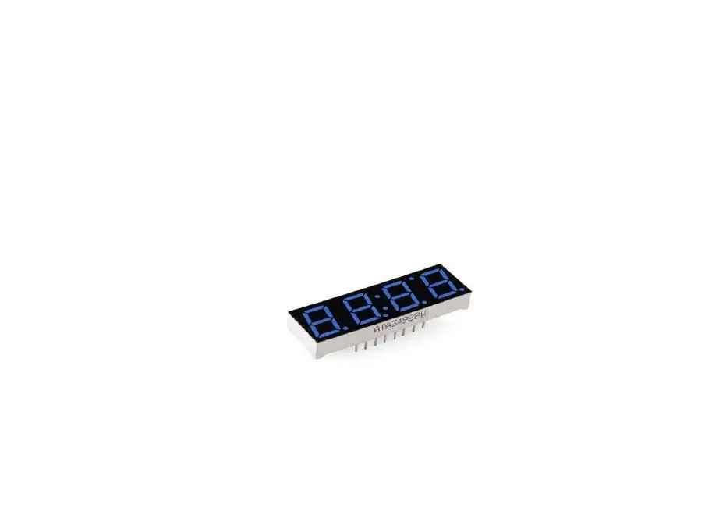
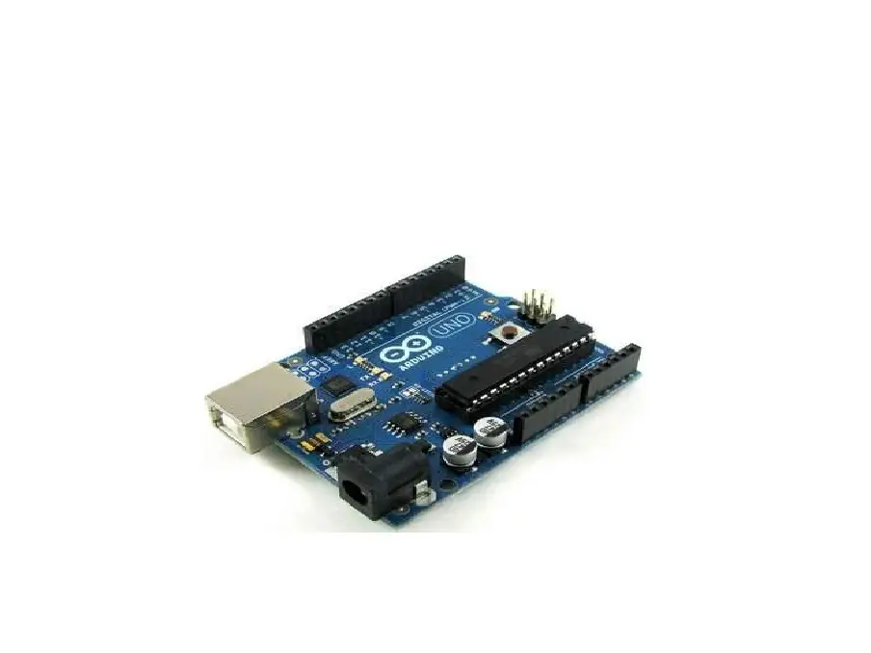
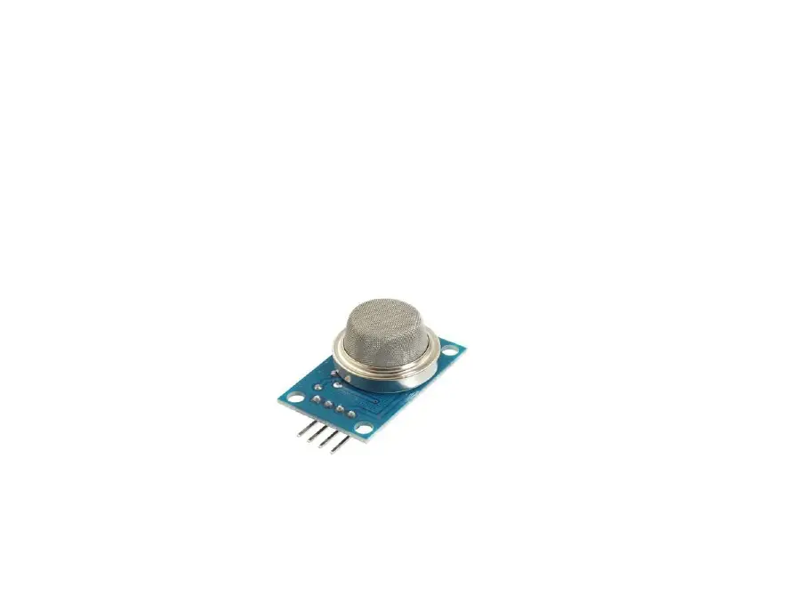
LED DISPLAY
ARDUINO
GAS SENSOR

Slide 6


WORKING
The working of our project is quite intuitive. When the Gas Leak Sensor, detects any gas leakage, it immediately changes the position of the servo motor; this is to indicate that the valve is being closed to avoid any further leakage. Along with this, the user has to be notified, so an alarm starts ringing. This uses the buzzer. And a red LED is used to indicate that there is a leak.

Slide 7
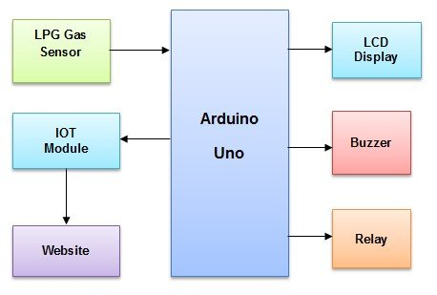

Slide 8

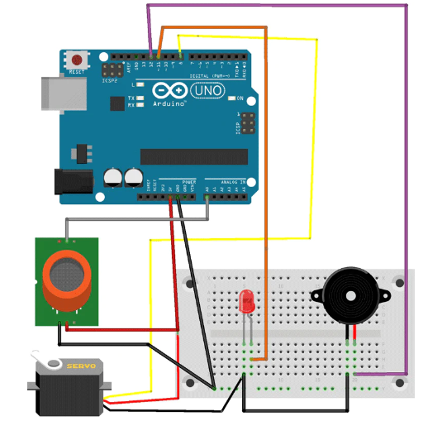


Slide 9
CODE EXPLANATION
#include<Servo.h> //include Servo header file
Servo servo;
int smokeA0=A0;
int buzzer =11;
int led = 12;
float sensorValue;
/* Initialize the pins A0, 11, 12 and create a float datatype to store sensor value*/
void setup() {
pinMode(buzzer,OUTPUT);
pinMode(led, OUTPUT);
pinMode(smokeA0,INPUT);
Serial.begin(9600); // sets the serial port to 9600
Serial.println("Gas sensor warming up!");
delay(20000); // allow the MQ-6 to warm up
servo.attach(8);
servo.write(0);
delay(2000);
void loop() {
sensorValue=analogRead(smokeA0);
if(sensorValue > 600)
{
Serial.print(" | Smoke detected!");
digitalWrite(buzzer,HIGH);
digitalWrite(led,HIGH);
servo.write(90);
delay(1000);
}
else
{
Serial.print(" | Smoke not detected!");
digitalWrite(buzzer, LOW);
digitalWrite(led,LOW);
servo.write(0);
delay(1000);
/* if the above condition is not satisfied then, we display that smoke is not detected and hence buzzer, led Is turned OFF and the servo is turned to 0 degrees which was its original position. A delay of 1ms is created. */
}
delay(2000); // wait 2s for next reading
}

Slide 10
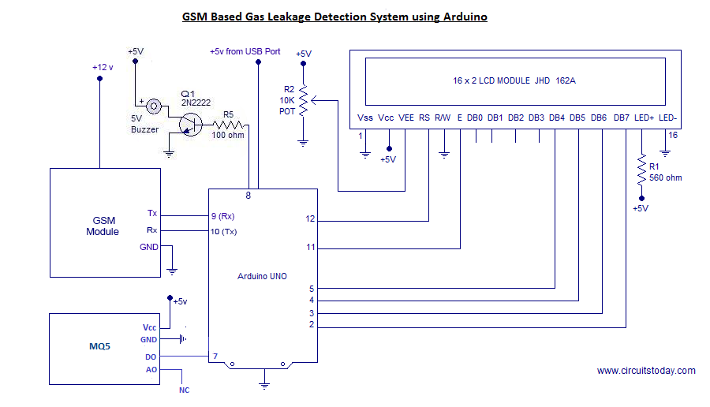

Slide 11
Thank You
PRESENTATION BY :-
ARCHITH SAI - 21BCE1139
APOORV D - 21BCE1169
SARVESH KADAM - 21BCE1183
ADITI JHA - 21BCE1198
SHIVANYA SINGH - 21BCE1231
SHASHANK KUMAR - 21BCE1233

